Slide 1
Saudi Costume

Slide 2
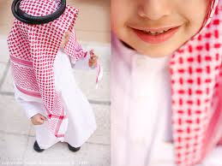
Saudi Men costume

Slide 3
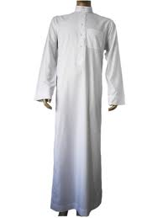
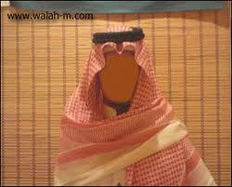
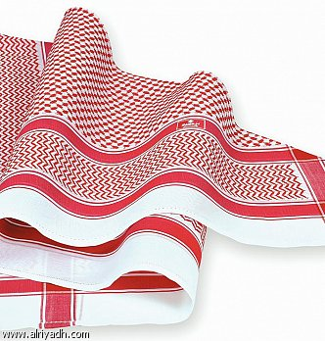
This white dress is called thowb. it makes from cotton and polyester. It wears at summer.
This is called shmack ,which is worn over a head.

Slide 4
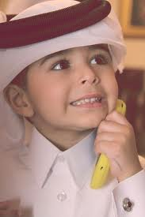
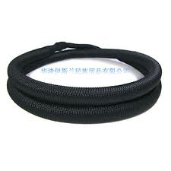
Getra is worn as shmack
Igal is worn above shmak or getra.

Slide 5
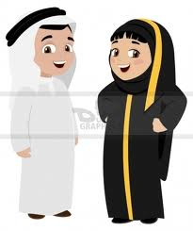
Saudi women costume

Slide 6
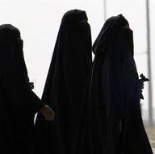
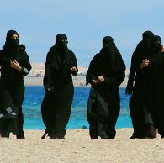
This is called abaia. It is worn out side home among strange men.

Slide 7
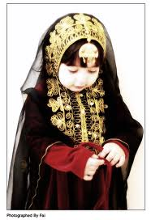
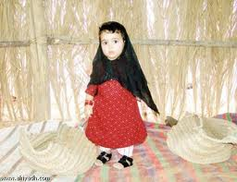
Those some traditional women clothes in the past.

